Slide 1
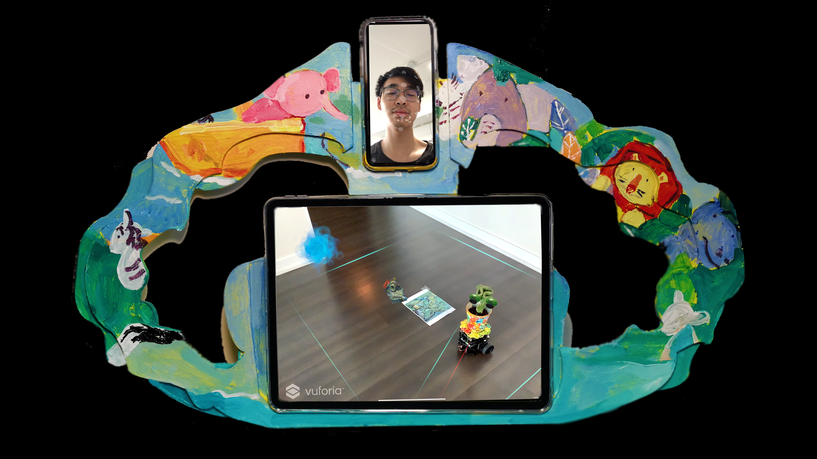
Right Eye Close
Turn Right

